Slide 1


HOW COMPLEXITY SCIENC E- AND ITS CON C EP*S- CAN CONTRIBUTE TO A BETTER UN DERSTAN DING OF "GENAI" COMPETITIVE DYNAMICS AN D TO THE DESIG N OF A PRO ACTIVE, PRO INNOVATION COMPETITION POLICY.
12 ^{O}
JUN E ”
VRIJE U IVERS TEIT AMS ERDAM
PROFSCHREPEL

Slide 2
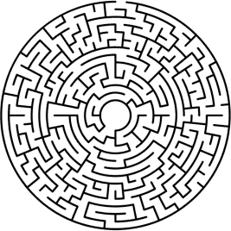
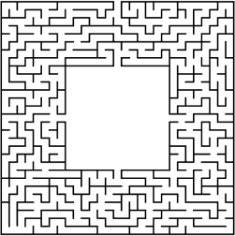
GenAI Competitive Dynamics and Challenges
OECD
@ProfSchrepeI
Pagel
1. Competitive dynamics in Generative Al
2. Pro-active competition law and policy

Slide 3
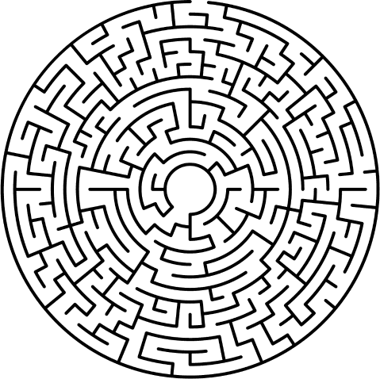



GenAI Competitive Dynamics and Challenges
OECD
@ProfSchrepeI
Page2
Competitive dynamics
i Generative i

Slide 4

GenAI Competitive Dynamics and Challenqes
OECD
@ProfSchrepeI
Page 3
Social media Search Online store
GenAl

Slide 5
GenAI Competitive Dynamics and Challenqes
OECD
@ProfSchrepeI
Page 4
J.J. Can we confidently predict who will ’win^{d}No.
fcomputer sci9ßC9j

Slide 6
GenAI Competitive Dynamics and Challenges
OECD
@ProfSchrepeI
Page 5
BIG DATA
Just *biq* data is the wronq focus:
Small datasets can compete with biq ones
Small companies can access larqe amounts of data
April 2023: Koala: A Dialoque Nodel for Academic Research
February 2022: Retrieval-Enhanced Transformer
- June 2021: Low-Rank Adaptation (LoRA)
September 2020: Less Than One-Shot Algorithms
February 2020: Dataset Distillation
April 2017: Attention Is All You Need
—1970s: Synthetic data
source

Slide 7
GenAI Competitive Dynamics and Challenges
OECD
@ProfSchrepeI
Page 6
COSTS
Today, it's expensive= favor biq players
— 0penAl spent $540 million on the development of GPT—4 in 2022 alone
— 0penAl spends $700,000 per day to run ChatGPT(2023)
But tomorrow? Chip makers are lowering these costs (Nvidia's latest GPU cut the price of training LLNs from $10 million with 960 CPUs down to just $400,000) + new model compression and algorithms that lower costs: one can train and run “good enough” LLNs on a single GPU (even smartphones) in just a few of hours + federated learning is pushing
source

Slide 8
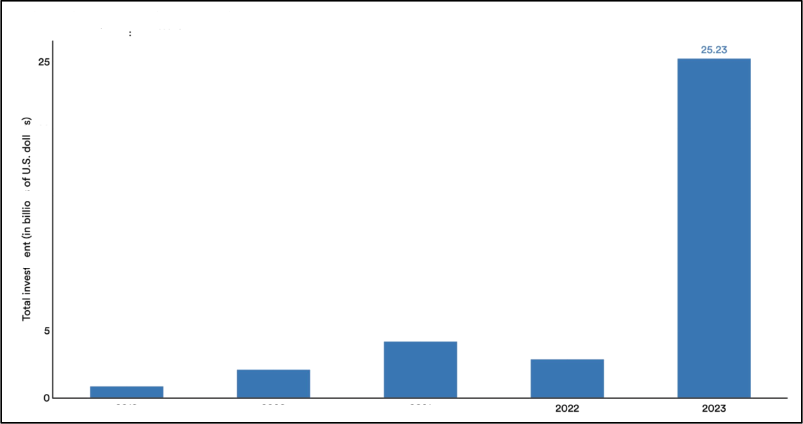

0enAI Competitive Dynamics and Challenges
OECD
@ProfSchrepeI
Page7
CAPITAL
Private investment in generative AI, 2019-23
Source: Quid, 2O2Z | Chart 2024 AI Index report
20
c 15
2019
2020
2021
source

Slide 9



GenAI Competitive Dynamics and Challenges
OECD
@ProfSchrepeI
Page 8
TALENT
Midjourney
Less than 50 employees
{https://www.crunchbase.com)
non-erqodicity

Slide 10

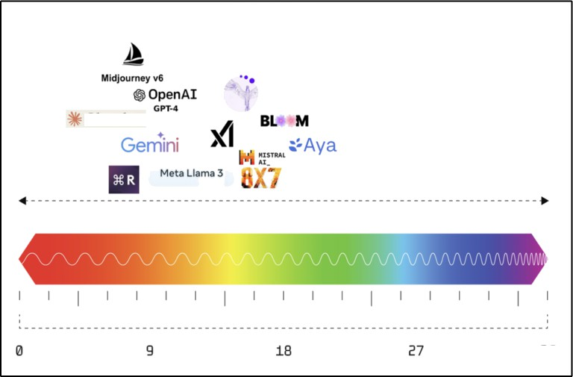
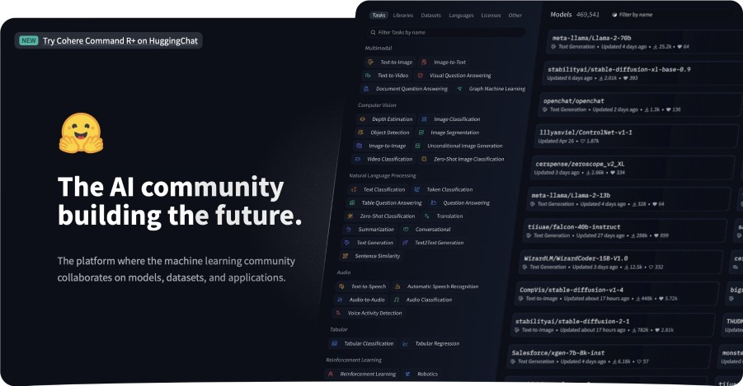
0enAI Competitive Dynamics and Challenges
OECD
@ProfSchrepeI
Page 9
Hugging Face
u odeTs
Datasets
Spaces
Posts
Docs
Pricing
Logtn
Claude 3
source
Some models are downloaded over 1 million times per month

Slide 11
GenAI Competitive Dynamics and Challenges
OECD
@ProfSchrepeI
10
’Open’ foundation models
power strong competitive dynamics:
They can be forked (1000 forks on Llama 3 in one weekend)= diversity
They include limited/distributed amendment and termination provisions
They include "anti-opportunism" provisions
They do not restrict interoperability / access to the API = little leveraging power (address many antitrust concerns)
source

Slide 12
OECD
GenAI Competitive Dynamics and Challenges
@ProfSchrepeI
Pagell
1.2. Does this imply that GenAI won't experience dominance? No.
(complexityscience)

Slide 13
GenAI Competitive Dynamics and Challenges
OECD
@ProfSchrepeI
Pagel2
INCREASING
RETURNS
Significant increasinq returns:
No immediate "/eorning effect":
not like search/socials, more like operating systems
But "ecosystem effects":
interaction between different layers (infrastructure - models - apps)
source

Slide 14
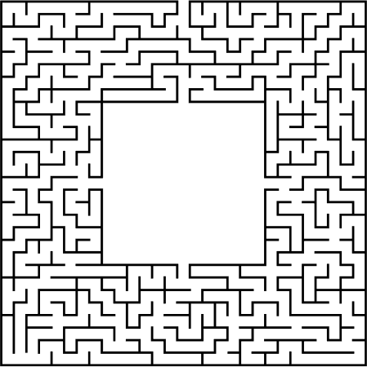

GenAI Competitive Dynamics and Challenges
OECD
@ProfSchrepeI
Page 13
Pro-active competition
iaw and poiicy

Slide 15


GenAI Competitive Dynamics and Challenges
OECD
@ProfSchrepeI
Pagel4
Follow increasinq returns
What qenerates these returns? (snowball effect)
Tarqet practices diminishinq these returns = freezinq the ecosystem
source

Slide 16
















GenAI Competitive Dynamics and Challenges
OECD
@ProfSchrepeI
Page 15
Foiiow increasinq returns
Users
I
I
the practice*
LE CHAT HI5TRAL_
Cloude
Depends on the
ability
t0
enter
OpenAl
NISTRAL
AI_
ANTHROP\C
AI foundation models
frozen layers
A»ML
aWS
nvioiA.
AI infrastructures
source

Slide 17



GenAI Competitive Dynamics and Challenges
OECD
@ProfSchrepeI
Page 16
Depioy computationai antitrust
E.g.: Audit code and T&C
- Track changes in the API (for the 'closed' ones)
- Trach changes in access terms to models(for the 'open' ones)
- Trach changes to non-compete provisions
- Track changes to interoperability terms
«ou_cer

Slide 18


















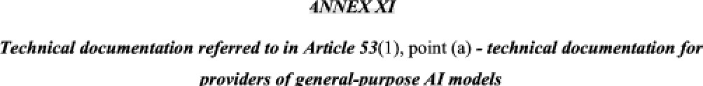
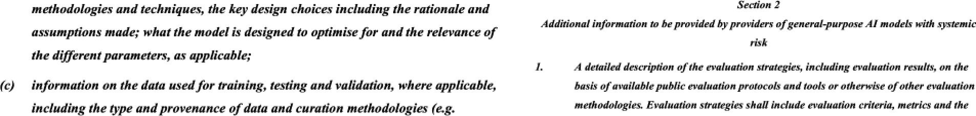
GenAlCompetitive Dynamics and Challenges
OECD
9ProfSchrepel
Page 17
re iato
ca res
10 m FE PXü DIGS FD
ba rs
Article 53 of the AI Act + Annex XI
(Providers of general purpose Al models)
«ou_cgr

Slide 19



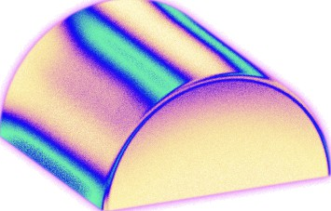
GenAI Competitive Dynamics and Challenges
OECD
@ProfSchrepeI
Pagel8
Exempt open systems
1. Forminq joint ventures (between OS/OA companies) without notifyinq antitrust aqencies
2. Forminq strateqic alliances without facinq cartel sanctions (sharinq up—front costs, marketinq networks, and technical knowledqe)
3. Creatinq/extendinq R&D exemption to antitrust law (25^{O}/o+ rivalry)
source

Slide 20
GenAI Competitive Dynamics and Challenges
OECD
@ProfSchrepeI
Page 19
t.schrepeipvu.nI

Slide 21
HOW COMPLEXITY SCIENC E- AND ITS CON C EP*S- CAN CONTRIBUTE TO A BETTER UN DERSTAN DING OF "GENAI" COMPETITIVE DYNAMICS AN D TO THE DESIG N OF A PRO ACTIVE, PRO INNOVATION COMPETITION POLICY.
12 ^{O}
JUN E ”
VRIJE U IVERS TEIT AMS ERDAM
PROFSCHREPEL

